Slide 1

Finance and Risk analytics:
Prepared by: Krishna S
Maria J Peter
Kishlay Sahay

Slide 2

Agenda:
Objective
Solution approach
Insights & Visualization
Portfolio analysis

Slide 3

Objective:

Slide 4
The objective is to analyze a portfolio of stocks and provide consultation on investment management based on client’s requirement.
There are 2 different types of investors namely Mr Patrick Jyenger and Mr Peter Jyenger to whom it is necessary to provide the financial solutions.
Mr Patrick Jyenger is interested to invest $500K in equities, he has been conservative investor during his all life and expects doubling his capital with less risk in 5 years of time.
Mr Peter Jyenger on the other hand is interested to invest $1 million in equities, he has been high risk investor during his all life, prefers high return investment and expects doubling his capital with high risk in 5 years of time.

Slide 5

Solution Approach:

Slide 6
Exploratory Data Analysis:
Datasets were verified for null values and ensured there are no any columns/rows containing null values.
The dataset was checked to understand for any outliers.
Imputed “0” value for FB data that was containing few null values.
Data Analysis:
Various calculations, including daily returns, cumulative daily returns, Sharpe ratios, portfolio risk, and Return On Investment were performed to analyze the stock data.
Discovered the best performing stocks for all portfolios.
Tableau was used for visualizations.
Performed sector wise analysis to get a better insights of each sector.
Inferences from the data after our analysis:
Stocks of AMZN, MSFT, AAPL, FB, UNH, GOOG and MS are performing better compared to others.
Each stock has different risk and reward according to its annualized risk, Sharpe ratio and cumulative returns.
It was identified that stock of AMZN yields highest return among all stocks but has high risk involved when compared with stocks.
It is also discovered that stocks like JNJ, RHHBY, MRK and MSFT have good returns with less risk.
Among all sectors, Technology is performing better followed by Finance and the worst is Aviation followed by Health and Pharma.
Finally, portfolio of both the customers are analysed and finalized.

Slide 7

Insights & Visualizations:

Slide 8
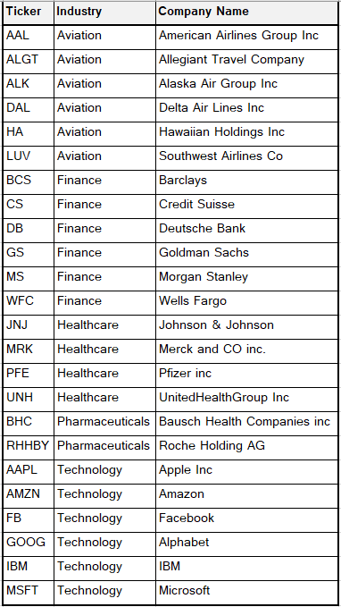
Stocks Data:
There are a total of 24 stocks available from four sectors that contain 6 stocks from each sector.
There is an index available to compare the stocks outcome with S&P500 that is a combinations of top 500 stocks in US stock market.
There are list of stocks with their abbreviation, Industry and Company name.

Slide 9
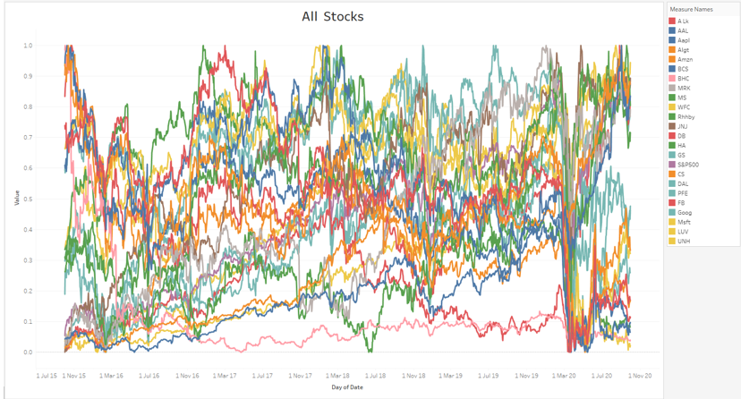
Stocks visualization after normalizing all the values:
The graph illustrates how each stock has fared in relation to the S&P 500 index.
5 years' worth of stock values for every stock is compared.
Every stock in each sector is plotted for different intervals to facilitate sector-wise analysis of each stock.

Slide 10
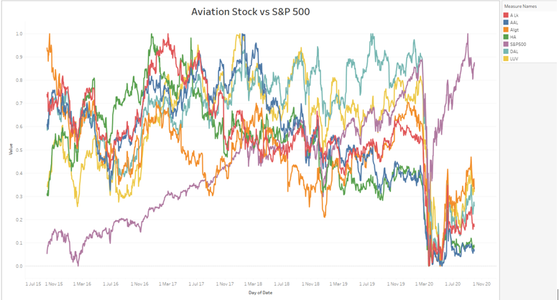
Stocks visualization of Aviation sector:
The stock market took a massive hit in 2020 due to Covid pandemic that resulted in a bear market.
S&P500 is not co-related to Aviation sector.
Though the market recovered later, the Aviation Sector underperformed the market.
From our analysis, we observed some positive correlation of Delta Airlines with Southwest Airlines.

Slide 11
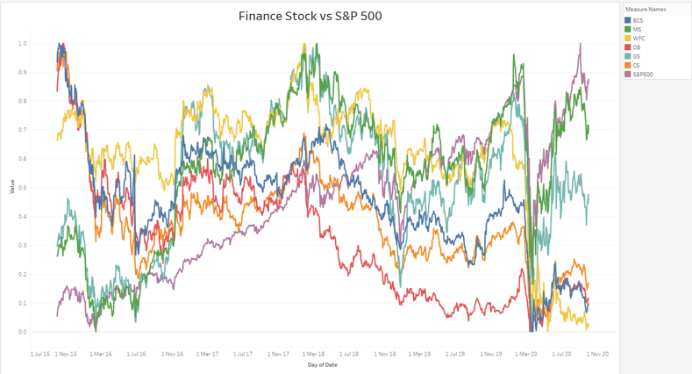
Stocks visualization of Finance sector:
S&P500 is positively co-related with Finance sector.
Even though market took a massive hit in 2020 due to Covid pandemic, Morgan Stanley and Goldman Sachs were able to recover back and out-performed the sector but still majority of their stocks have been a hit.
From our analysis, we observed that Goldman Sachs & Morgan Stanley are highly correlated when compared to other stocks.

Slide 12
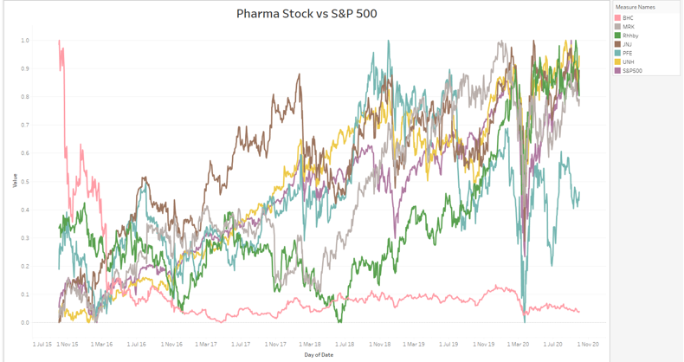
Stocks visualization of Pharma_Healthcare sector:
Pharma_Healthcare sector is strong as compared with S&P500.
S&P500 is positively co-related with Pharma_Healthcare sector stocks JNJ, MRK, UNH.
During the Covid pandemic, Pharma_Healthcare sector along with Technology sector showed a rapid growth after the market crash compared to other industries.

Slide 13
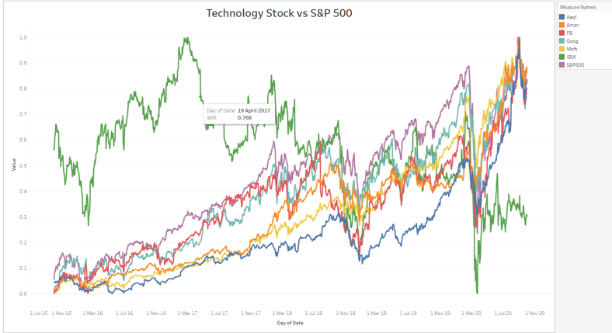
Stocks visualization of Technology sector:
S&P500 is strongly co-related with Technology sector stocks AMZN, FB, MSFT, GOOG, AAPL.
Technology sector bounced back strongly post Covid pandemic compared to other sectors.
During our analysis, we found that all the stocks except for IBM are strongly co-related with each other, and they are performing exceptionally well.

Slide 14
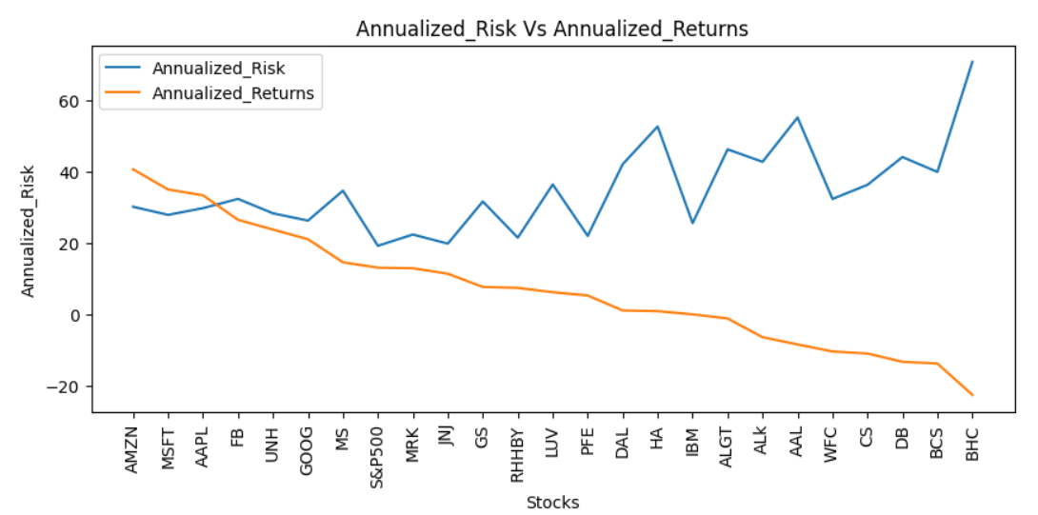
Insights from Annualized return & Annualized risk:
The top five stocks by Annualized return are AMZN, MSFT, AAPL, FB, and UNH.
The Annualized return on each of the top 5 stocks is greater than 20 as compared to other equities, the risk of these five stocks is moderate.
The likelihood of losing money and depleting the initial investment increases with decreasing return.
There is a bigger risk for BHC, BCS, DB, CS, and WFC since ROI is not being provided as during the time of investment.
The riskier the company, the lower is the ROI it offers, although there are some stocks that offer risk-free investment opportunities even if they don't offer the best returns.
Stocks like JNJ, RHHBY, and MRK offer a good return with minimal risk.

Slide 15
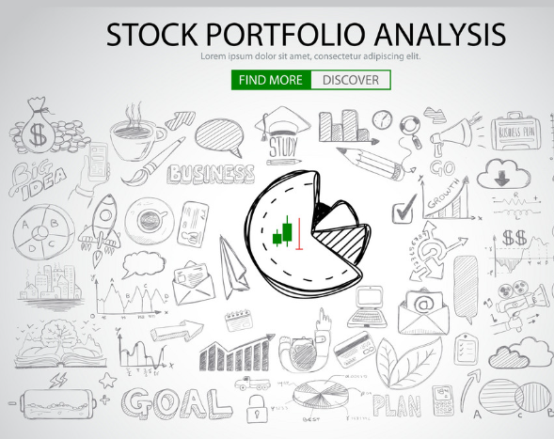
Portfolio Analysis:

Slide 16
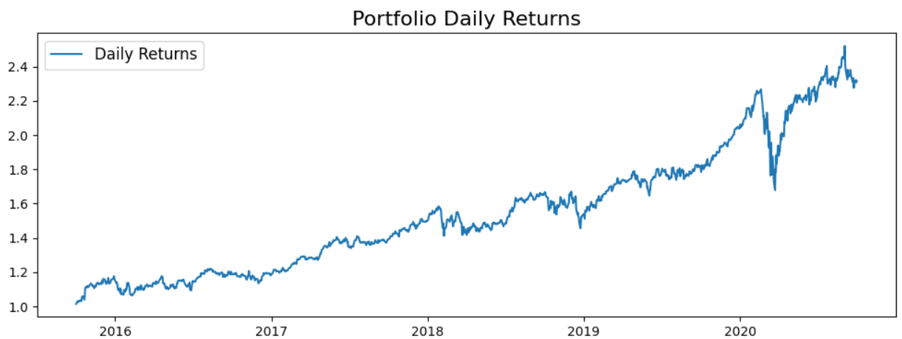
Patrick Jyenger
Mr. Patrick Jyenger aims to triple his investment in next 5 years of time. He seeks low-risk investments that will yield respectable profits.
Low risk equities like JNJ, RHHBY, and GOOG are appropriate to buy, based on his profile. However, the combined returns from these three equities would fall short of his investment goal. Therefore, he can invest a portion of his wealth on MSFT to generate the needed profits.
Mr. Patrick Jyenger, having all stock weights equal, the overall weight is 0.25.
Mr. Patrick Jyenger invests 5 Hundred thousand dollars in equities. The returns that he would get after 5 years will be 1.15 Million dollars which is more than 6 Hundred thousand dollars of gain.

Slide 17
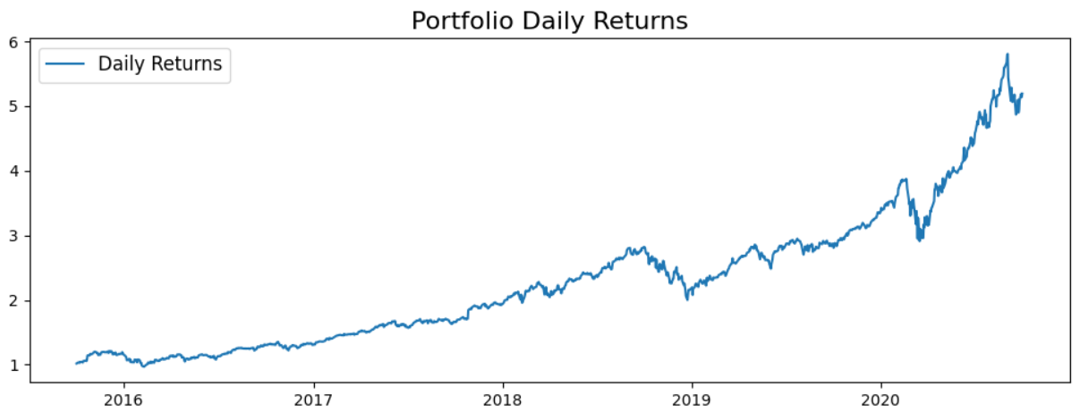
Peter Jyenger
Mr. Peter Jyenger is more inclined towards risk, and he prefers high-return investments.
He wants to invest 1 million dollar from company's cash and cash equivalents in the most high-margin stocks which expects high returns within 5 years for inorganic expansion of his company.
As per his profile high risk/high returns stocks like AMZN, MSFT and AAPL are suitable to invest upon.
The returns with these stocks would fetch him maximum returns and cater the risk.
Mr. Peter Jyenger invests 1 Million dollars in equities. The returns that he would get after 5 years of time is more than 5 Million dollars with more than 4 Million dollars of gain.

Slide 18
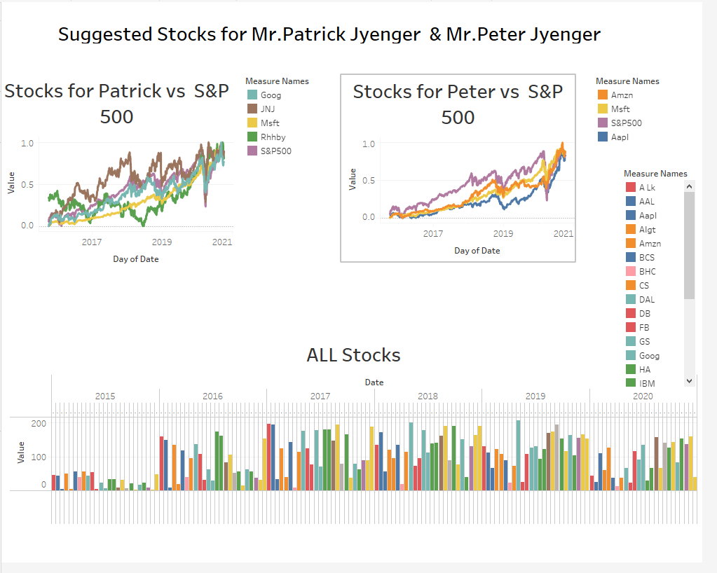

Slide 19
Thank you..

